Slide 1
JavaScript Essentials
Objects

Slide 2
Table of Contents
Overview - Object basics
Dot notation
Bracket notation
Setting object members
Q&A

Slide 3

Lesson Objectives
Understand the fundamental JavaScript object syntax
Understand the basic theory behind object-oriented programming, how this relates to JavaScript ("most things are objects"), and how to start working with JavaScript objects
Able to access and setting member in Object using Dot notation and Bracket notation

Slide 4
Overview – Object basics
Section 1

Slide 5
Overview – Object basics
An object is a collection of related data and/or functionality (which usually consists of several variables and functions — which are called properties and methods when they are inside objects.)
Let's work through an example to understand what they look like.

Slide 6
Overview – Object basics
Syntax to create an Object:
Notes:
As with many things in JavaScript, creating an object often begins with defining and initializing a variable. Try entering the following line below the JavaScript code that's already in your file, then saving and refreshing:

Slide 7
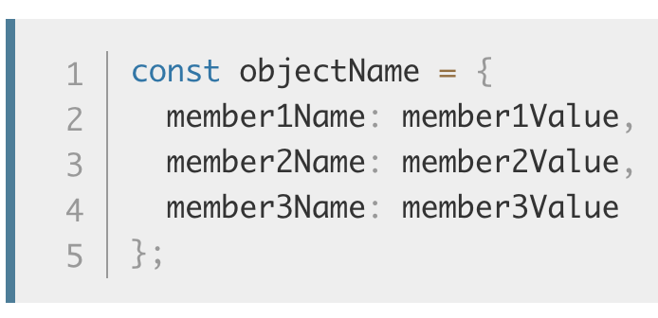
Overview – Object basics
Syntax to add member to Object
Notes:
So what is going on here? Well, an object is made up of multiple members, each of which has a name (e.g. name and age above), and a value (e.g. ['Bob', 'Smith'] and 32). Each name/value pair must be separated by a comma, and the name and value in each case are separated by a colon.
The syntax always follows this pattern:

Slide 8
Overview – Object basics
To represent a Fresher Angular

Slide 9
Overview – Object basics
The value of an object member can be pretty much anything — in our person object we've got a string, a number, two arrays, and two functions.
The first four items are data items, and are referred to as the object's properties.
The last two items are functions that allow the object to do something with that data, and are referred to as the object's methods

Slide 10
Overview – Object basics
An object like this is referred to as an object literal — we've literally written out the object contents as we've come to create it.
Notes:
This is in contrast to objects instantiated from classes, which we'll look at later on.
It is very common to create an object using an object literal when you want to transfer a series of structured, related data items in some manner, for example sending a request to the server to be put into a database.
Sending a single object is much more efficient than sending several items individually, and it is easier to work with than an array, when you want to identify individual items by name.

Slide 11
Overview – Summary
An object is a collection of related data and/or functionality (which usually consists of several variables and functions — which are called properties and methods when they are inside objects.)
The value of an object member can be pretty much anything
If it’s a value we refer to it as a property
If it’s a function we refer to it as a method

Slide 12
Overview – Summary
Object literal - we've literally written out the object contents as we've come to create it
Object is much more efficient than sending several items individually, and it is easier to work with than an array, when you want to identify individual items by name

Slide 13
Dot notation
Section 2

Slide 14
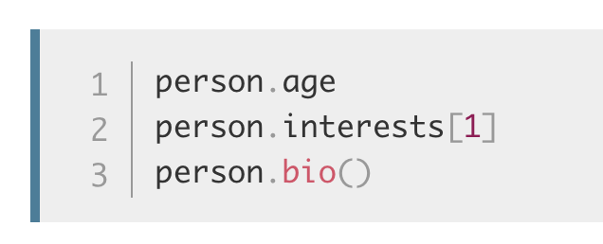
Dot notation – Basic syntax
Above, you accessed the object's properties and methods using dot notation. The object name (person) acts as the namespace — it must be entered first to access anything encapsulated inside the object
Next you write a dot, then the item you want to access — this can be the name of a simple property, an item of an array property, or a call to one of the object's methods, for example:

Slide 15
Dot notation – Sub namespace
It is even possible to make the value of an object member another object. For example, try changing the name member:

Slide 16
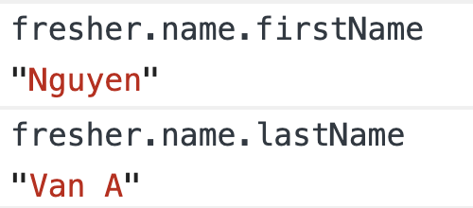
Dot notation – Sub namespace
Here we are effectively creating a sub-namespace. This sounds complex, but really it's not — to access these items you just need to chain the extra step onto the end with another dot. Try these in the JS console:

Slide 17
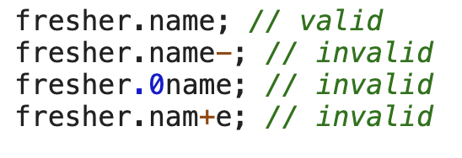
Dot notation – Sub namespace
Note: when using Dot notation the keyword on the right of Dot must be a valid identifier

Slide 18
Dot notation - Summary
To access member of an object use Dot nation
The object name acts as the namespace — it must be entered first to access anything encapsulated inside the object
We can create sub-namespace by setting value of a member to another object

Slide 19
Bracket notation
Section 3
Notes:
Assignment operators

Slide 20
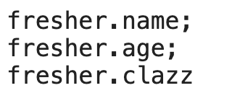
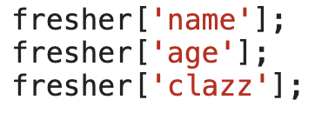
Bracket notation
There is another way to access object properties — using bracket notation. Instead of using these:
You can use

Slide 21
Bracket notation
With this notation, you can use variable to access a member
This looks very similar to how you access the items in an array, and it is basically the same thing — instead of using an index number to select an item, you are using the name associated with each member's value.
It is no wonder that objects are sometimes called associative arrays — they map strings to values in the same way that arrays map numbers to values.

Slide 22
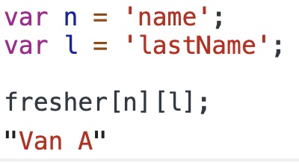
Bracket notation
Access member using variable:

Slide 23
Bracket notation – Summary
Use Bracket notation to access a member using either ‘string’ or a variable
If it’s a variable inside Bracket, then JavaScript will resolve the value of that variable and access the member of corresponding key
Objects are sometimes called associative arrays

Slide 24
Setting object members
Section 4
Notes:
Assignment operators

Slide 25
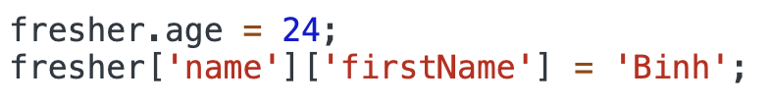
Setting object members
So far we've only looked at retrieving (or getting) object members — you can also set (update) the value of object members by simply declaring the member you want to set (using dot or bracket notation), like this:

Slide 26
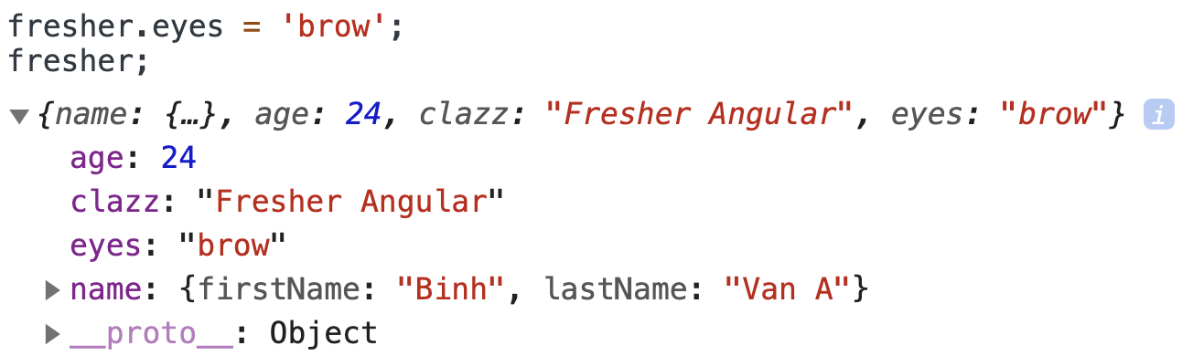
Setting object members
Setting members doesn't just stop at updating the values of existing properties and methods; you can also create completely new members. Try these in the JS console:

Slide 27
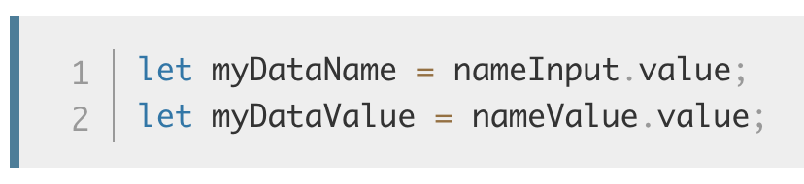
Setting object members
One useful aspect of bracket notation is that it can be used to set not only member values dynamically, but member names too.
Let's say we wanted users to be able to store custom value types in their people data, by typing the member name and value into two text inputs. We could get those values like this:

Slide 28
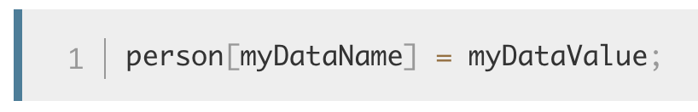
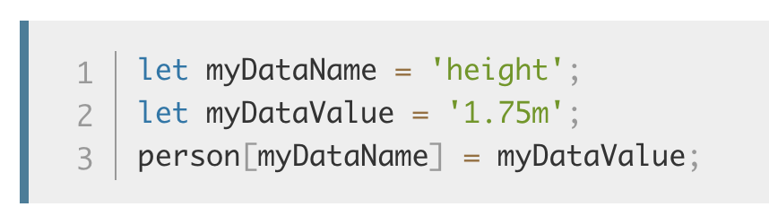
Setting object members
We could then add this new member name and value to the person object like this:
To test this, try adding the following lines into your code, just below the closing curly brace of the person object:

Slide 29
Practice 1
Practice 1: Setting object members
Notes:
Practice setting object members
Check Unit 6 – Practice 1 folder

Slide 30
Setting object members – Summary
To setting object members you can use either dot notation or bracket notation
Then use assignment (=) to set value
If the memberKey does exists then the value is updated
If the memberKey doesn’t exists, then a new member will be created

Slide 31

Thank you
Q&A

